Slide 1
Reliability
(in development)
This section will introduce you to the distribution system reliability analysis module.

Slide 2
What is the reliability module?
Works in conjunction with the powerflow module
Performs faults on a distribution system
Reports indices based around the IEEE 1366-2003 standard

Slide 3
How does it work?
Monitors meters and triplex-meters (customer loads)
  All customers are treated equally
Provides “scheduled” or random faults to a distribution system
  Specified general object (e.g., overhead line)
  Specified fault (L-G, L-L, L-L-G, 3-L-G)
  Specified duration (Mean Time to Restoration)
  Specified frequency of occurrence (Mean Time To Failure)
Performs the fault, collects outage information, and collects metrics – not a detailed fault analysis tool

Slide 4
Objects in Reliability Module
object eventgen {
char256 groups;
char256 targets;
double frequency[1/yr];
double duration[s];
char256 values;
}
Defines fault object category
Defines fault type
Defines fault circumstances
Initial – may differ in final implementation

Slide 5
Objects in Reliability Module
object metrics {
char1024 report_file;
    }
Collects the system statistics
Relates results to “customers” (meters)
Outputs results to report_file (reliability.csv if unspecified)
Initial – may differ in final implementation

Slide 6
Reliability Output
Log of events (if specified) – Fault locations and timing
SAIDI – System Average Interruption Duration Index
SAIFI – System Average Interruption Frequency Index
CAIDI – Customer Average Interruption Duration Index
ASAI – Average Service Availability Index

Slide 7


Reliability Output Explained
SAIDI – Total interrupt duration for average customer during defined time
SAIFI – Frequency average customer experiences a sustained interruption

Slide 8
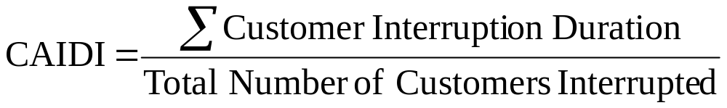

Reliability Output Explained
CAIDI – Average time required to restore service
ASAI – Average fraction/percentage of time that a customer received power

Slide 9
Sample Reliability Output
Reliability report for reliability_test_new.glm
Number of customers: 3
EVENT LOG FOR YEAR 2000
=======================
Event DateTime Affects Prop Values T_int L_int N
1 2000-01-05 03:23:25 EST Link12 status OPEN 0.77 8614678.086 3
2 2000-01-29 12:19:53 EST Link34 status OPEN 0.38 2121.495 1
3 2000-01-30 11:52:49 EST Link12 status OPEN 0.06 8614678.086 3
4 2000-02-19 05:27:57 EST Link23a status OPEN 0.05 4081.820 1
.
.
27 2000-12-11 08:14:27 EST Link12 status OPEN 2.51 8614678.086 3
Annual reliability metrics report for 2000
==========================================
SAIDI SAIFI CAIDI CAIFI ASAI
70774 15.00 4517 1.00 86.534658

